Slide 1
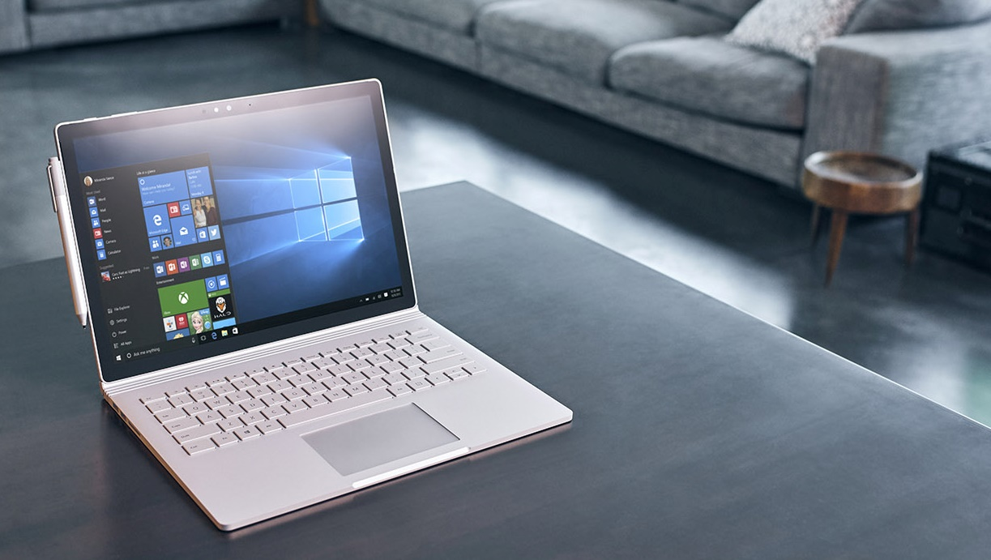
Getting to know Windows 10 – for employees
Microsoft IT Showcase
microsoft.com/itshowcase

Slide 2
Familiar, and better than ever
Windows 10 is the best combination of the Windows you already know, plus lots of great improvements you’ll love having. Our new Creators Update is designed to spark and unleash creativity, bringing 3D and mixed reality to everyone. Beyond creativity, it adds security capabilities and privacy tools on top of what was already available in Windows 10.
Microsoft IT Showcase

Slide 3
Start fast, stay focused, finish first
Windows gives you the absolute best experience for quickly getting things done. Start fast with all your favorite apps and files immediately at hand. Quickly take action with meaningful notifications collected in one place. And stay focused with easy ways to snap apps in place, create new desktops, and organize your screens just the way you want.
Start fast and smart The Start menu is better than ever. Pin your go-to apps and files for fast access. You can even pin underlying content to jump right into a specific post or song. Live Tiles beam updated info—like weather and headlines—so you don’t need to open the app. And get recommendations for apps that are likely to become your new favorites.
Getting to “done” is a snap Multi-task like a master and spend less time moving things around. Building on the ability to have up to four apps on one screen, Snap Assist makes it easy to snap apps into place to optimize available screen space. You can also slide the shared edge of snapped desktop apps to wherever you want it, easily resizing both apps in a single motion, just like you would in Tablet Mode.
One place for taking action Action Center displays your key notices—app notifications, proactive Cortana notifications and key settings—in a single spot. Notifications are more meaningful and present logical next steps, so you have everything you need for taking action, from small tweaks like adjusting screen brightness to more complex functions like replying to emails and missed calls without having to first open the app.
Control your desktop Get great new ways to keep command of your desktop. Use the task view button to see open apps and files in a single view. If your screen is getting crowded, you can create virtual desktops with just the items you want—great for when you don’t have multiple monitors to work with. Easily switch between desktops using one of the many new trackpad motions for quick navigation.

Slide 4
The new Start menu
By popular demand, Windows 10 brings back the familiar Windows desktop and Start menu from Windows 7. The Start menu is enhanced with resizable tiles and new capabilities to help you be more productive.
From the Start menu, you can:
Lock your computer, change your account settings, or sign out.
Quickly access your apps—traditional and modern. Plus access documents, pictures, and settings.
Shut down your computer, restart it, or put it to sleep.
Search for apps, settings, and files, and search across the web.
Immediately launch advanced system tools such as Power Options and Disk Management.

Slide 5
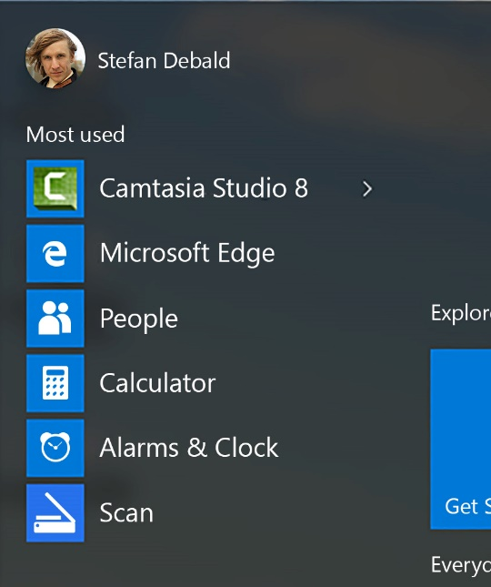
The Start menu: More options added
On the left side of the Start menu you’ll find:
Links to your most used and recently added apps.
Links to File Explorer and Settings.
The Power button.
To launch an app, select it.
To choose from a broader range of options, right-click the app. Options include:
Pin to Start
More
Uninstall
To lock your computer, change your account settings, sign out, or switch your account:
On the Start menu, select your user name.
Choose the option you want: Change account settings, Lock, Sign out, or Switch account.

Slide 6
Finding your app with Task View
Many people know that you can press Alt +Tab to switch between running apps.
In Windows 10, the new Task View button on the taskbar make this feature more discoverable.
Virtual desktops are also managed through Task View.
To select an app:
Select the Task View button on the taskbar.
Select the app.

Slide 7
Virtual desktops
Windows 10 adds support for virtual desktops, so you can keep your open apps better organized.
For example, if you need to research travel plans for an upcoming business trip while at work, you could create a second virtual desktop that contains the apps you’re using to research and plan your trip.
To create a new virtual desktop:
Select the Task View button on the taskbar.
Select New Desktop near the lower-right corner of the screen.

Slide 8
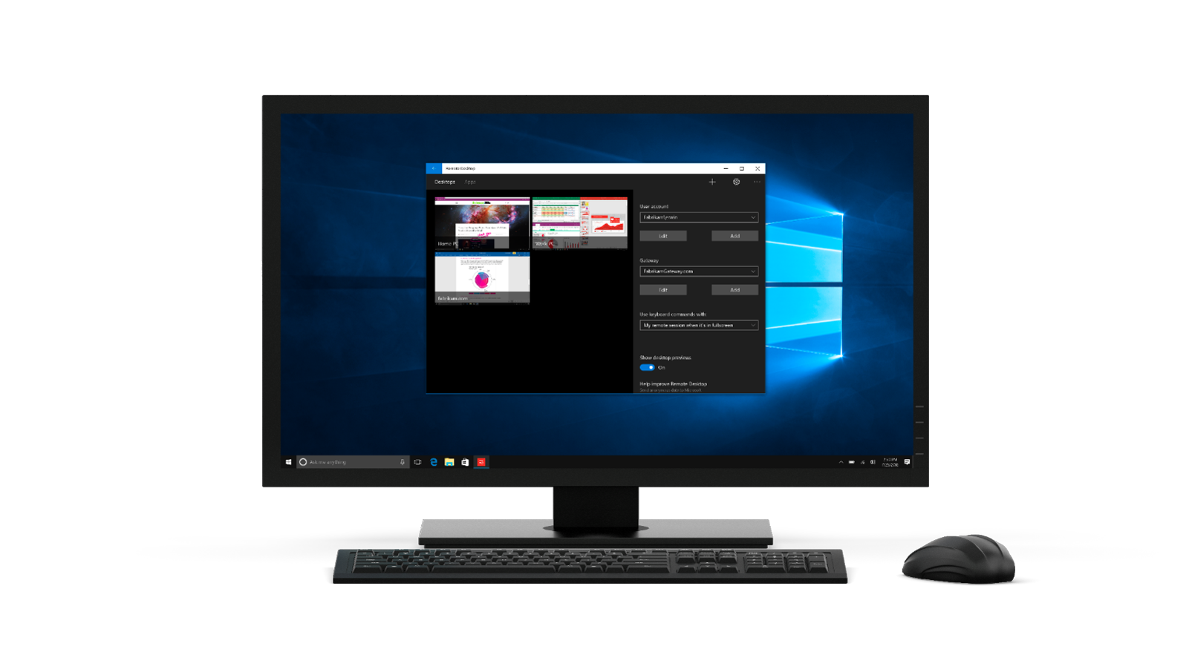
Remote desktop
Access all of your files, folders, and apps from virtually anywhere.
Be productive no matter where you are. Log onto your desktop or tablet to access all of your files, folders, and apps from virtually anywhere as if you were there in person. Get the full Windows experience from a remote location. All you need is an internet connection and Remote Access.
Connects with Active Directory or Azure Active Directory. Windows 10 Pro has always supported remote connections to PCs that are joined to Active Directory. You can also connect to a remote PC that is joined to Azure Active Directory (Azure AD).
Freedom on the fly. Get all the benefits of being at an office even when you’re away from it. Use Remote Desktop (via a Remote Desktop Gateway) to connect to a corporate PC without having to establish a VPN connection.

Slide 9
Comprehensive, built-in security
Windows 10 was built to be the most secure version of Windows ever. With comprehensive, built-in security features, it provides protection from viruses and malware threats—including ransomware—safer authentication with Windows Hello using your smile or fingerprint to login, plus ongoing security updates delivered monthly through Windows Update.
Security and health that you can see. The Windows Defender Security Center lets you see and control device security and health options from a single dashboard display. Also, your Microsoft account page displays security and health status for all your Windows PCs and tablets.
Control over app installation. New settings allow you to specify which apps can be installed. You can choose to allow only Windows Store apps to install, blocking apps that could pose potential security or performance issues. Great if you are the one who is expected to keep grandpa’s PC clear of sketchy downloads that could degrade security or performance.
Remote lock. Windows Hello can use your smartphone to detect when you step away from your PC or tablet, automatically locking it behind you for an extra measure of security and privacy. Works with smartphones, fitness bands, or any other device that’s paired to your PC or tablet.

Slide 10
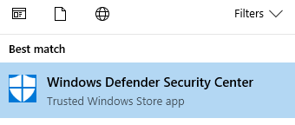
Windows Defender Security Center
The new Windows Defender Security Center makes it easier for you to view and control the security protections you choose and better understand the security features already protecting you on your Windows 10 device.
To open Windows Defender Security Center
Enter Windows Defender Security Center in the search box on your task bar. Then select the best match suggestion from the search results.

Slide 11
Windows Hello
Fast and password-free. With Windows Hello, you can sign into your Windows devices in less than 2 seconds—that’s 3 times faster than a password that you have to remember and type in. Windows Hello uses your face or fingerprint to recognize you instantly. You can always keep your PIN as a backup if you choose.
Enterprise-grade secure. Windows Hello uses biometric sensors to recognize you apart from all others, so when you unlock your device with a look or a touch you get a superior level of enterprise-grade protection. You can even add multiple profiles so that each family member gets their own biometric sign-in.
Quick sign-in to apps and websites too. Windows Hello works with compatible apps—including iHeartRadio, Dropbox, Putti Forms, Weibo, Taobao, One Auth, Passwords10 and Enpass—so you can bypass the password and breeze right through. It waves you into websites too, as long as you're using Microsoft Edge. So site sign-ins are fast and password-free, with an extra measure of security.
Your companion devices unlock your PC. Windows Hello lets you use your digital wristband, smart watch, phone and other companion devices to quickly unlock your Windows PC without using a password. By already certifying your identity, these devices give you another choice for quick, secured sign-ins.
Tap to pay. Secured by Windows Hello. With a compatible Windows 10 phone and the Microsoft Wallet app, you can use Windows Hello for extra of security with contactless in-store purchases.

Slide 12
Advanced security features are changing the game for security
Windows provides a set of advanced, integrated security capabilities designed for the modern and sophisticated threats that individuals and organizations face today.
By protecting your identity, devices, apps, data, and infrastructure, Windows 10 makes security even stronger.
Security features include:
Windows Defender Antivirus
Windows Hello
Windows Information Protection
Anti-ransomware
Windows Defender Advanced Threat Protection
Credential Guard
Device Guard

Slide 13
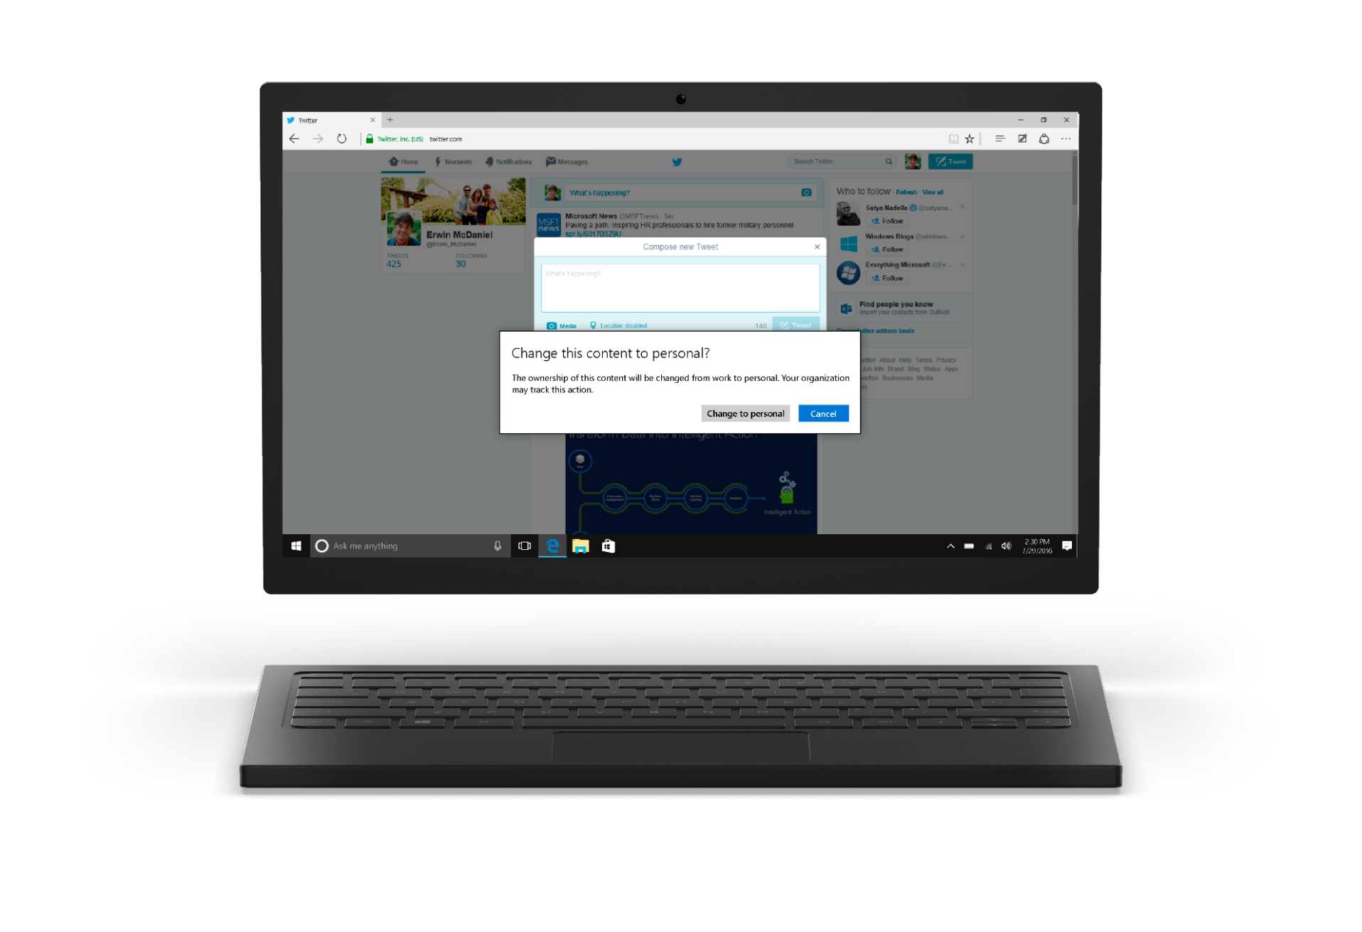
Windows Information Protection
With the increase of employee-owned devices in businesses, there’s also an increasing risk of accidental data leak through apps and services, like email, social media, and the public cloud. Windows Information Protection (WIP), previously known as enterprise data protection (EDP), helps to protect against this potential data leakage.
Separate personal and professional data. WIP helps prevent accidental data leaks by separating personal and business data. WIP allows IT admins to apply rules to control how business data can be used. It recognizes business data as it arrives on devices, is generated by business apps, or when it is designated as business data by the user.
User and app access control. WIP enables IT to set policies that define which apps and users are authorized to access business data. WIP also enables IT to define which rights a user has, allowing IT to either help block leaks or, optionally, help warn the user before content is copied to unauthorized websites and personal documents.
Provides greater IT control with a seamless experience for users. In Windows 10 Pro and Enterprise editions, business data protection takes place completely behind the scenes, only notifying users when they’re attempting to take an unauthorized action. The IT team has full control to perform a remote wipe of business data on demand while leaving personal data untouched.

Slide 14
Cortana
Cortana is your personal digital assistant in Windows 10. She’s always at the ready, bringing you exactly what you need without disturbing the conversation.
Cortana gets to know you over time, using your search information to help you get things done and becoming more useful every day.
To ask Cortana a question:
Select the circle to the right of the Start button.
Note: To get the most out of Cortana, you must be signed in with your Microsoft account (such as Hotmail, Outlook, or Windows Live).
Microsoft IT Showcase

Slide 15
Cortana at work
Cortana is the only digital personal assistant that can work for you at home and at work. By helping you remember things so nothing falls through the cracks, integrating with the tools you already use, and gaining knowledge of your organization, Cortana helps you do your best job.
A smarter digital assistant. A more productive you. Office 365 and Cortana work together to help you get more done. Cortana helps you prepare by collecting into one view information about the people you are meeting with, files you worked on together and relevant communications.
Cortana can also alert you when you have conflicting, late or early meetings so you can take action.
And, Cortana helps you quickly find people in your organization, documents stored in the cloud or on your PC and emails.
Gets you the information you need. Cortana integrates with other Windows apps, so you can turn an inked Sticky Notes in to a reminder and easily create, add to and open your Wunderlist lists with voice or text from Cortana.
Cortana enables a natural language interface for Power BI to get you instant answers, along with visual interpretations of company-owned data.
Cortana integrates with the tools you already use to get you the business information you need quickly.
Cortana remembers, so you don’t have to. Cortana proactively notifies you about commitments and deadlines you’ve made through email, tracks flights and packages, and helps you pick up where you left off when switching devices or restarting.

Slide 16
What can Cortana do?
Cortana can search the web, find things on your PC, show you the local news and weather, and provide reminders based on time or location.
Some things you can say to Cortana include:
Remind me of meeting tomorrow.
What is the current Microsoft stock price?
Remind me to go for a walk in 30 minutes.
When is the next Toronto FC game?
What is the weather forecast for Mexico City on Friday?
Cortana even adapts her behavior to your device, using your Microsoft account to help you out across all your Windows 10 devices. When you’re on your phone, interaction will generally be brief. And when you’re on your PC, Cortana can help deliver steady periods of productivity. Of course, you’re always in control of what she knows and what she manages on your behalf.

Slide 17
Cortana’s Notebook
Cortana keeps track of everything she knows about you in Cortana’s Notebook, including what you like and what you want her to do.
To display Cortana’s Notebook, do one of the following:
From Cortana, select the Notebook button.
— OR —
Select the Menu button, and then select the Notebook button.

Slide 18
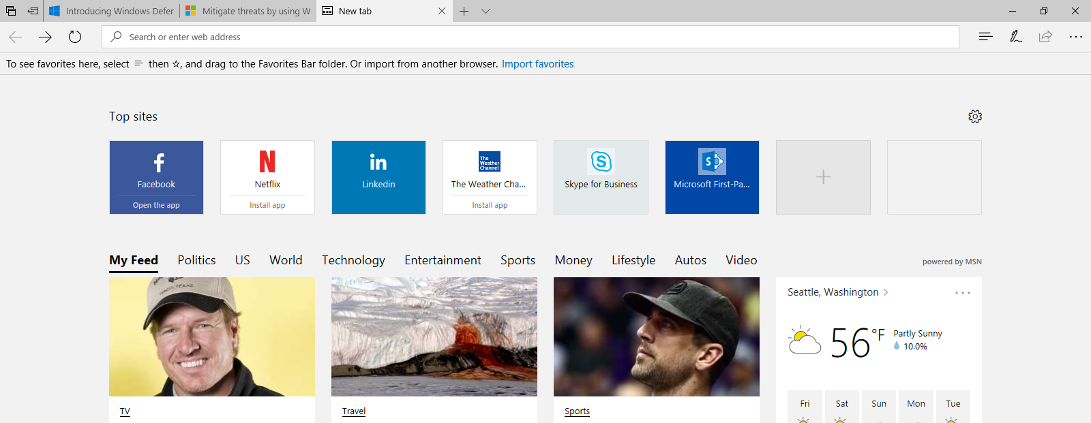
Microsoft Edge
Microsoft Edge, the new browser in Windows 10, is designed to deliver a better web experience. It’s fast, compatible, and built for the modern web—designed to work the way you do and help you get things done through easy sharing, reading, discovery, and more.
Browse and stream longer. As the browser built for Windows 10, Microsoft Edge is optimized to perform great on your PC. With better power efficiency than other popular browsers, you can get up to 53% more battery life when you browse the web with Microsoft Edge.
When streaming HD video, Microsoft Edge lasts up to 69% longer than Firefox and 45% longer than Chrome.
When you want to search for something, there’s no need to go to a website. Enter your search in the address bar at the top of the screen, and you’ll get search suggestions and results from the web, your browsing history, and your favorites—right on the spot.
Be safer than Google Chrome. Don’t surf with sharks. Protect yourself from phishing attacks. And when combined with Windows Defender, you can trust that your PC is safer with antivirus protection that’s built-in to Windows 10.
Microsoft IT Showcase

Slide 19
Microsoft Edge: Secure by design
Microsoft Edge helps protect you from phishing schemes and malicious software while you're online, so you can browse more confidently. And when combined with Windows Defender, the antivirus protection that’s built-in to Windows 10, you can trust that your PC is safer.
Quicker, more secure way to log into websites. Microsoft Edge supports Windows Hello, the biometric sensor that lets you log in to websites with a look or a touch instead of a password.
Safer web browsing. Microsoft Edge has a security sandbox and Windows Information Protection, and supports only newer, more secure web technologies.
Windows Defender Application Guard provides virtualization-based security to isolate Microsoft Edge, protecting Windows 10 against advanced attacks.
Windows Defender provides:
Virus protection and removal
Malware protections and removal
Spyware detection and removal
Boot-time protection
Real-time protections
Cloud-based protection
Network inspection

Slide 20
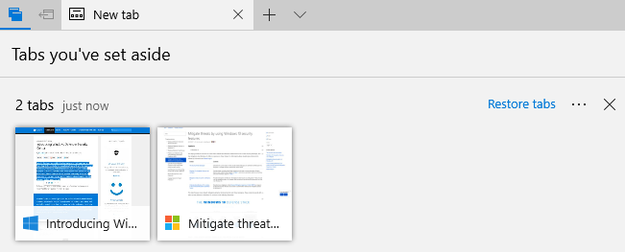
Microsoft Edge: Say goodbye to tab chaos.
The Set Tabs Aside feature will make you more productive than ever while browsing the Internet. With one click, set tabs aside to get a fresh browser look. Tabs are set aside chronologically, so you can easily restore these previously stored tabs in a couple of clicks. This feature is great for managing tabs for different projects, clients or meetings.
To set aside tabs you might want later:
Select the Set Aside icon.
.
To bring the tabs back:
First select the Restore icon, and then select Restore Tabs.
To see all of your tabs at once:
Select the down arrow icon at the top right

Slide 21
Microsoft Edge and the Hub
The Hub is the place where Microsoft Edge keeps the things you collect on the web—including your favorites, reading list, browsing history, and current downloads.
To open the Hub:
Select the Hub button.
To change views:
Select a button at the top of the Hub:
Favorites
Reading List
Books
History
Downloads

Slide 22
Microsoft Edge and Web Notes
Microsoft Edge is the only browser that lets you take notes, write, doodle, and highlight directly on webpages—and then save your “Web Notes” for later or share them with others. Web Notes are collected on the Hub and can be shared to other programs, such as Microsoft OneNote.
Within Web Notes, you can:
Select Make a Web Note to display the Web Note toolbar , where you can:
Draw on the page.
Highlight content.
Erase everything you’ve added to the page.
Comment on something.
Clip part of the page.
When you finish creating a Web Note, you can:
Save the Web Note to Favorites or Reading List.
Share the Web Note via OneNote or to Reading List.
Exit the Web Note toolbar to close it and return to the normal view.

Slide 23
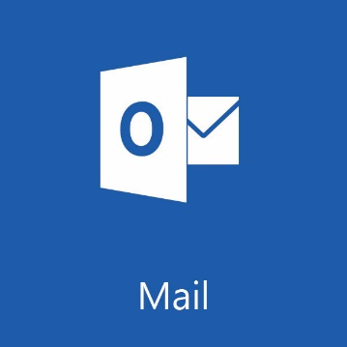
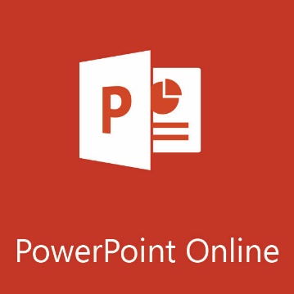
Using Microsoft Office 365 with Windows 10
Microsoft Office 365 is the Microsoft suite of cloud-based services and productivity tools. They help you work and collaborate wherever you are, online or offline.
Along with access to communication and collaboration services like Skype for Business and Microsoft SharePoint Online, Office 365 includes:
Microsoft Outlook
Microsoft Word
Microsoft Excel
Microsoft PowerPoint
Microsoft OneNote
You can use all of these programs on virtually any device.
Microsoft IT Showcase

Slide 24
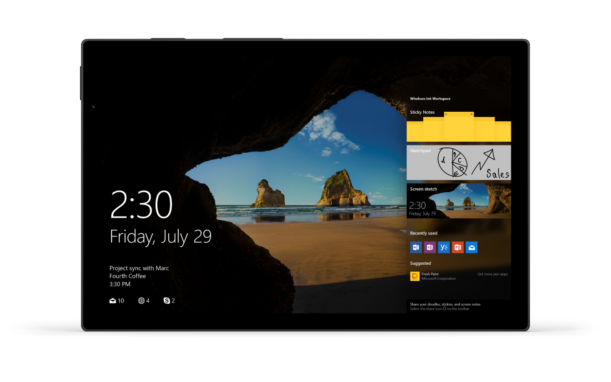
Productivity gets fun with Microsoft Office 365 with Windows 10
Reach new levels of productivity when you run Office apps on Windows. New and exciting features—like Windows Ink, your digital assistant Cortana, and the ability to use your phone to run Office apps on a second screen—are great ways to multiply the power of Windows 10 with Office.
With Windows Ink, you can edit your Word documents with your digital pen, for drawings that get converted into shapes.
Cortana is tightly integrated with Office apps. In addition to helping with emails and scheduling meetings, Cortana can surface relevant files and info before the meeting.
Only Windows lets you use your phone to run Office apps on a bigger second screen—expanding your freedom to be productive anywhere.

Slide 25
Office 365 and OneDrive for Business: Start by signing in to Office 365
To work with files on OneDrive for Business, you first need to sign in to Office 365 and create or open OneDrive:
On the Office 365 sign-in page, enter your user name and password, and select Sign in.
Select OneDrive on the global navigation bar.
The OneDrive for Business page opens.

Slide 26
Office 365 and OneDrive for Business: Share a file
After you create or upload a file, you may want to share it. By default, any file or folder you create in OneDrive for Business is invisible to everyone unless you create it in the Shared with Everyone folder in OneDrive for Business. When you share a file, you can optionally choose to start following the file. When you follow a file, you get updates in your SharePoint Online newsfeed when other people edit the file. People with whom you’ve shared the file can also choose to follow it.
To share a file:
On the OneDrive for Business – Files page, select the More button next to the file that you want to share, and then select Share Link.
In the Share dialog box, enter the names or email addresses of the people you want to share with, and then enter a personal message (optional).
Select Share.

Slide 27
Office 365 and OneDrive for Business: Synchronize a file
Using OneDrive for Business you can synchronize a file for offline use.
To synchronize a file in OneDrive for Business:
In OneDrive for Business, select the Sync button in the upper-right corner of the global navigation bar.
Select Sync now, and then follow the on-screen instructions.
A OneDrive for Business folder (OneDrive @ Microsoft) is created for you in File Explorer.
Save your file to the OneDrive @ Microsoft folder on your computer.
If you’re offline, as soon as you connect to the Internet your file will be synced to OneDrive for Business.

Slide 28
Personalization and settings—A new look
Settings got a makeover—and dropped “PC” from its name.
To learn about settings:
Go to Start > Settings.
Have fun browsing the categories. Try using search to find something in one of your files or on the web, and check out the advanced options in Control Panel.
Most apps have their own settings—look for the Settings icon in the app.
Tip: You can change common settings (such as airplane mode and Wi-Fi) on the fly from the Action Center on the taskbar.
Microsoft IT Showcase

Slide 29
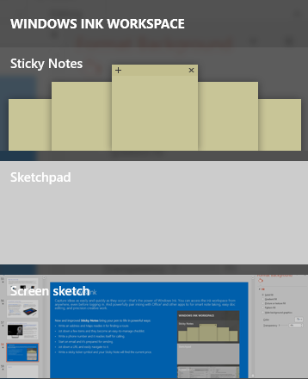
Windows Ink
Capture ideas as easily and quickly as they occur—that’s the power of Windows Ink.
You can access the ink workspace from anywhere, even before logging in. And powerfully pair inking with Office and other apps to for smart note taking, easy doc editing, and precision creative work.
Here are a few of the great Windows Ink features:
In one easy-to-access workspace, Windows Ink brings together three ink-powered features: Sticky Notes, sketchpad, and screen sketch. With the click of your digital pen, you can start writing or drawing right away.
Windows Ink integrates what you type or write with Cortana and apps like Maps and Mail to help you do typical business activities more quickly.
Windows Ink combines the naturalness and speed of pen and paper with the power of a computer.
Microsoft IT Showcase

Slide 30
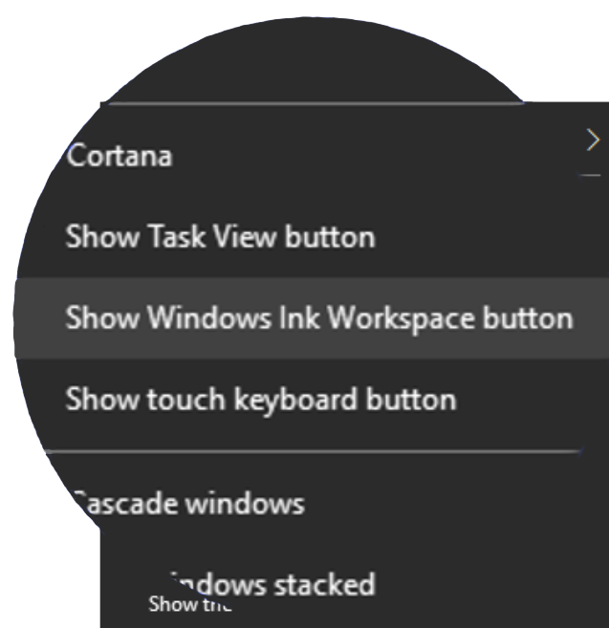
Getting started with Windows Ink
Capture ideas quickly.
Once Windows Ink is open, you can write on a Sticky Note, draw something on the sketchpad, or take a screen capture to draw or write on.
To open Windows Ink:
Select the Windows Ink Workspace icon in your taskbar in the lower right part or your screen, or click the back of your digital pen.
If you don’t see the icon, right-click anywhere in your taskbar and then select Show Windows Ink Workspace button.
Create ideas and images with sketchpad
The sketchpad is a simple blank canvas where you can draw an idea, doodle, and solve problems. Use the digital ruler with Windows Ink to measure distance or trace along a straight edge, just like on paper.
Write and draw on screen captures
Whether it's a doc, webpage, photo, or app, use Windows Ink screen sketch to take a screen capture, crop it if you want, mark it up, and share it in one click.

Slide 31
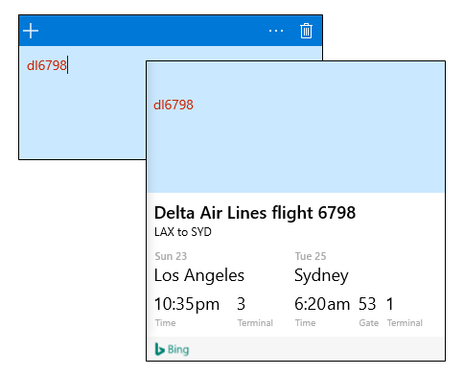
Sticky Notes are more useful than ever
Windows Ink Workspace integrates with Cortana to make Sticky Notes ever more powerful. Cortana recognizes and then turns certain types of content that you write on a Sticky Note into text that you can click to take different actions.
New and improved Sticky Notes bring your pen to life in powerful ways
Write an address and Maps readies it for finding a route.
Jot down a few items and they become an easy-to-manage checklist.
Write a phone number and it readies itself for calling.
Start an email and it’s prepared for sending.
Jot down an URL and easily navigate to it.
Write a sticky ticker symbol and your Sticky Note will find the current price.
Write down or type a flight number, then use it to track your itinerary
Click the flight number to see your flight details. Add yourself a reminder using Cortana. Your Sticky Note adds your flight information and tracks the flight. And, it’s available to refer to whenever you want.

Slide 32
Paint 3D: Discover the possibilities
With Paint 3D built into your Windows 10 PC, you can start creating in every dimension to bring your ideas to life. Whether you’re doing quick image editing or creating a 3D prototype of your idea, Paint 3D helps you discover new possibilities for thinking, creating, and communicating.
3D prototyping made easy With the new Paint 3D app, it’s a snap to prototype your idea by creating objects in 3D from scratch or modifying objects from the 3D library. Easily change color, texture, materials, or turn a 2D picture into a 3D scene. When you’re ready, use it in a PowerPoint or print in 3D.
Simple image editing Crop, edit save—Take advantaged of the new modern interface and save time with a tool that seamlessly removes people and objects and auto-fills the background.
Find your inspiration Paint 3D’s built in integration with Remix3D.com provides you instant access to a library of pre-made 3D models for you to customize and edit to use in presentations.
Add “power” to your “point” 3D in Windows 10 works with PowerPoint so you can make better presentations starting now. Imagine giving your audience a 360-degree tour of the solar system or zooming deep into a moon crater.
Whether you’re adding one of your own creations or something from the creators community, 3D makes your slides punchier and more persuasive.
Microsoft IT Showcase

Slide 33
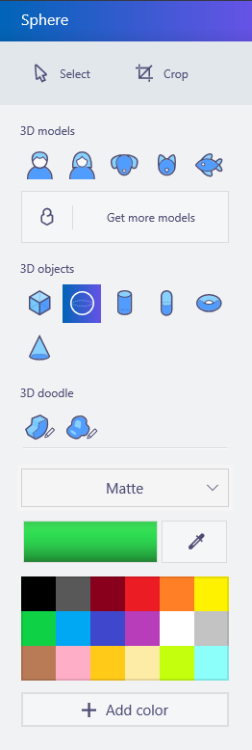
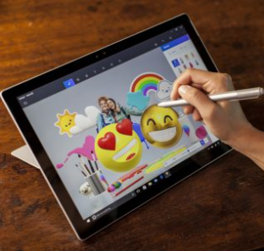
Paint 3D will surprise you
With beautiful colors, 10 types of markers, a large selection of 3D models, 2D shapes, stickers, and textures, Paint 3D enables limitless creative possibilities.
Open and view 3D models from the web, remix them with easy-to-use-tools, and debut your work on Remix3D.com.

Slide 34
Apps and the action center
Windows 8.1 enabled you to see notifications from apps, which appeared as “toasts” above the notification tray at the lower right of the screen. However, after a notification timed out, it was lost forever. Windows 10 remedies this with its new action center, which is similar to the notification center that was introduced in Windows Phone 8.1.
Within the action center, you’ll find:
A persistent list of notifications, so that you can view and address them at times of your choosing.
Links for performing quick actions, such as turning Wi-Fi on or off.
To open the action center, select the Action Center icon in the notifications area at the far right of the taskbar.
Microsoft IT Showcase

Slide 35
Meet the Surface family
Designed for Windows 10 Creators Update and the latest version of Microsoft Office, Surface takes full advantage of every innovation—including new 3D experiences, Windows Ink workspace, and comprehensive security features.
To do great things, you need powerful tools that deliver an ideal balance of craftsmanship, performance, and versatility. Every Surface device is engineered with these things in mind, and you at the center. And that’s how the Surface family does more. Just like you.
Surface Pro 4
The tablet that can replace your laptop
Surface Studio
Turn your desk into a studio
Surface Book
The ultimate laptop. Now more powerful than ever.

Slide 36
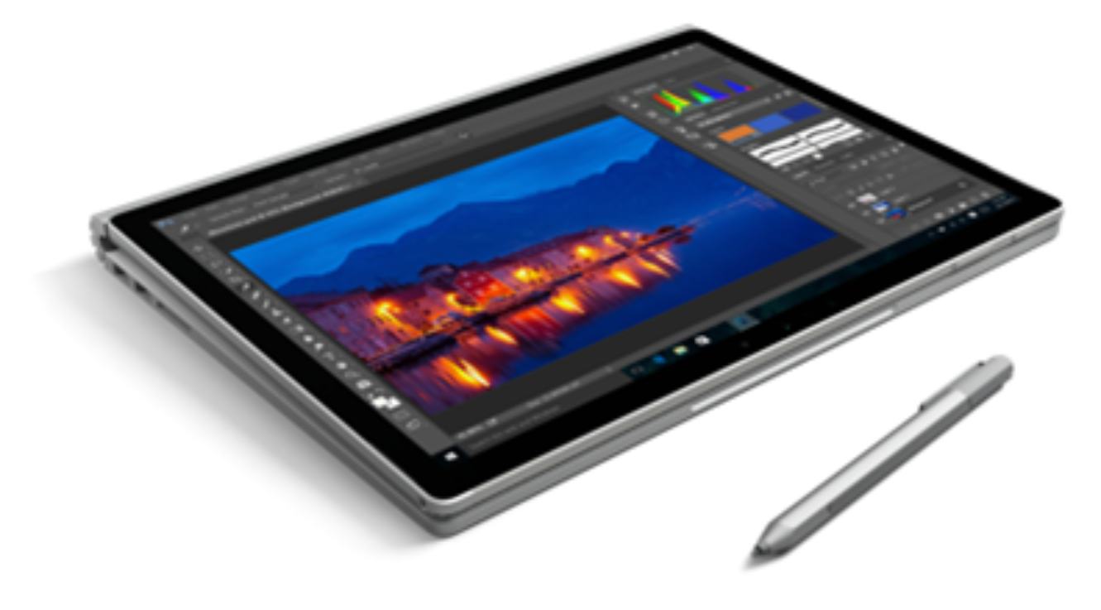
Surface Book: Stunning clarity
Creating will never be the same. Read, write, and doodle on a screen with a mind-blowing six million pixels!
First choice for creative professionals. Surface Book gives you access to the professional desktop software you already use, such as Adobe Photoshop and Illustrator, and with an optional discrete graphics chip, it’s got the horsepower to handle even the most intensive design tasks.
By making the screen detachable from the keyboard, people can use Surface Book in different ways:
In laptop mode, with the screen attached.
In clipboard mode, with the screen detached.
In canvas mode, with the screen turned around and reattached.
With these three different modes, Surface Book is the only laptop that can flex to the different ways people work best, giving you new opportunities to be creative and productive.
The Surface Book packs a punch when it comes to performance too. It’s twice as powerful as the MacBook Pro—and much faster—thanks to a 6th Gen Intel Core processor, up to 16 GB of memory, and best-in-class battery life.

Slide 37
Surface Studio: Turn your desk into a studio
Surface Studio is a whole new class of device, one designed for the creative process, for ideation.
Surface Studio is strikingly large and incredibly thin with a 28” PixelSense™ Display. Move the screen weightlessly from an upright Desktop Mode down into Studio Mode to angle it like a drafting table for pen and touch.
Immerse yourself in 4.5K resolution and 10-bit color depth. Visualize ideas as you paint, edit, and design.
The stunning screen is also perfect for collaborating with teammates or pitching your creative work.
A huge canvas; upright or like a drafting table, angled.
Strikingly large and incredibly thin display
Professional-grade power & performance
Meticulously crafted with a minimal and modern design

Slide 38
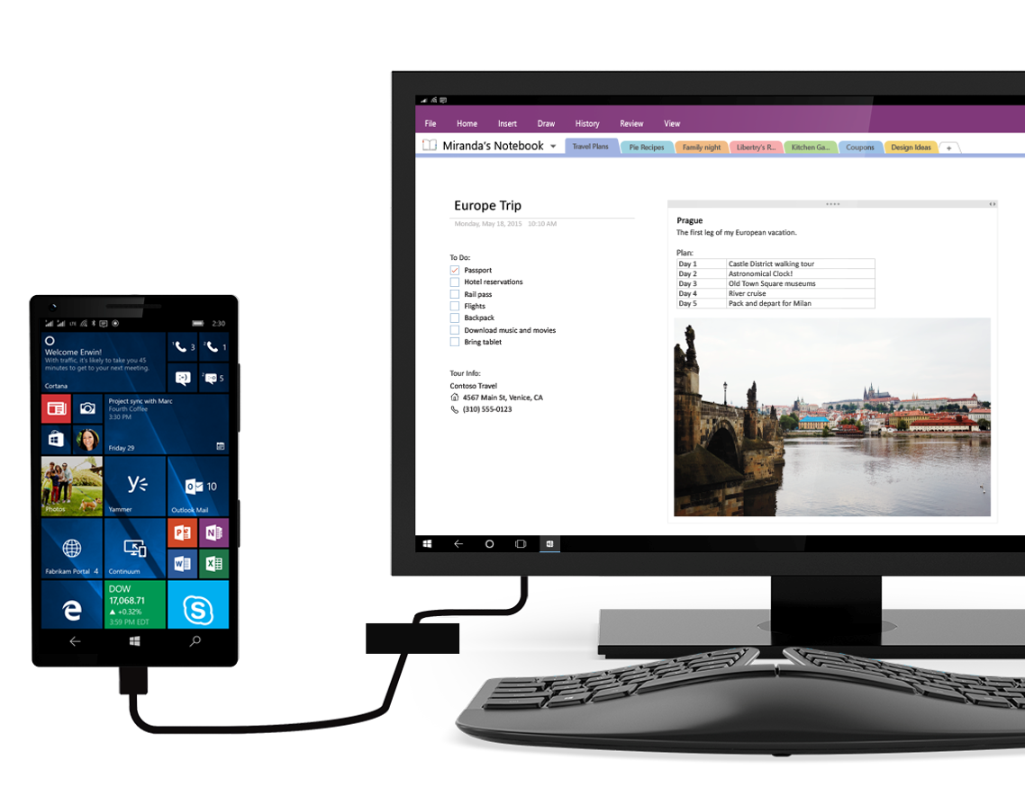
Continuum for phones
Continuum for phones gives you a second screen with the same easy navigation that you get on your PC. Your phone’s start screen is your start menu, Cortana is right there on your task bar, and your apps scale smoothly up to the biggest big-screen TVs—for a beautiful experience that’s far superior to mirroring.
Use your phone like a PC Use your phone like a PC to get incredible productivity that fits in your pocket. Connect a monitor, keyboard and mouse or use your phone screen as your virtual trackpad and keyboard.
You’re all set to touch down and get right into email, browsing and working with Office apps.
You can still use your phone for all the calls, texts, tweets, and things you do on your phone without interrupting the apps on the larger monitor.

